Slide 1
HEART DISEASE DIAGNOSTIC ANALYSIS
View in Power BI

Slide 2
PROBLEM STATEMENT
Health is real wealth in the pandemic time we all realized the brute effects of covid-19 on all irrespective of any status. You are required to analyze this health and medical data for better future preparation.
Do ETL: Extract- Transform and Load data from the heart disease diagnostic database You can perform EDA through python. The database extracts various information such as Heart disease rates, Heart disease by gender, by age. You can even compare attributes of the data set to extract necessary information.
Make the necessary dashboard with the best you can extract from the data. Use various visualization and features and make the best dashboard Find key metrics and factors and show the meaningful relationships between attributes. Do your own research and come up with your findings.

Slide 3
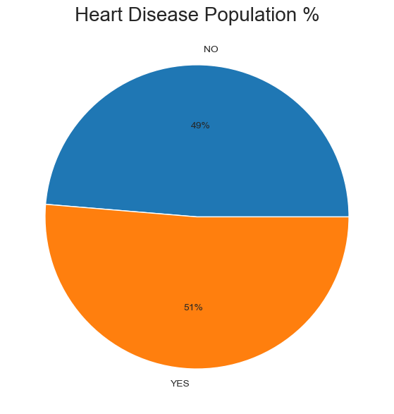
Percentage of People having Heart Disease
From the overall population, people having heart disease (51%) are greater than those who have heart disease(49%)

Slide 4
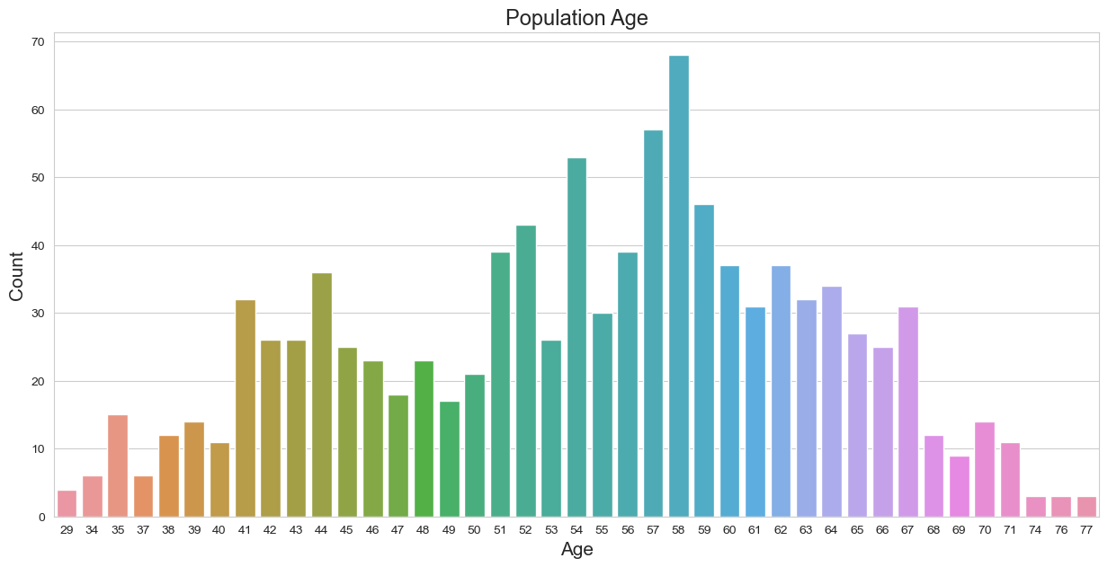
Population based on their Age
-> In this section, the best analysis can be divided into the elderly, middle-aged, young people by looking at the age ranges.

Slide 5
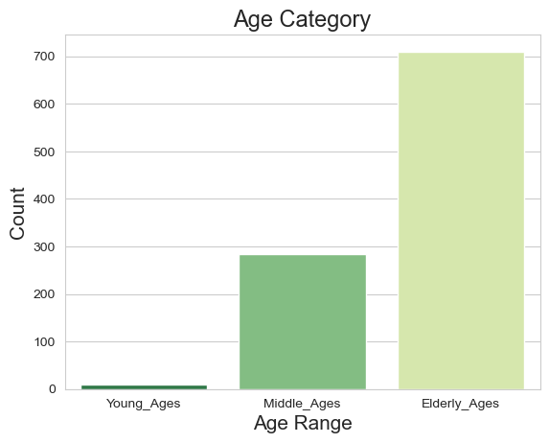
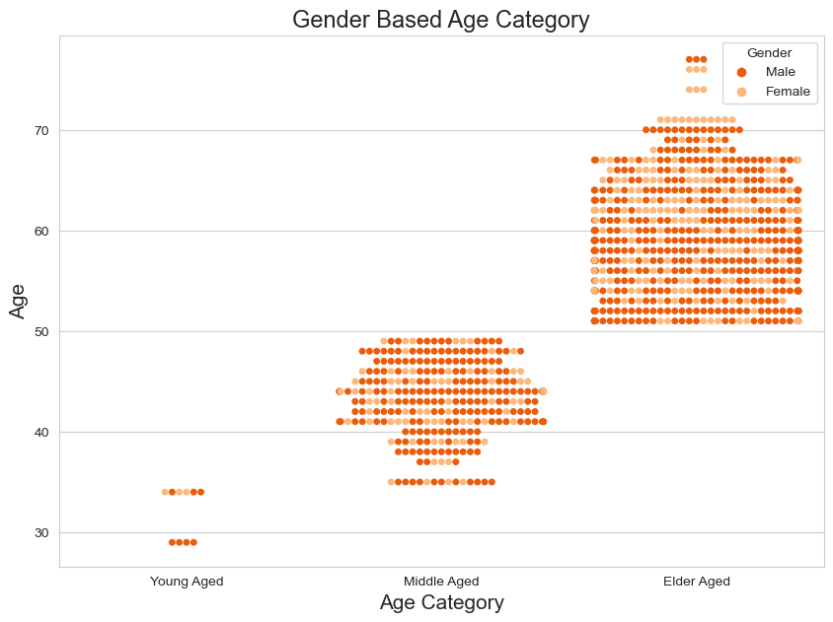
Age Category

Slide 6
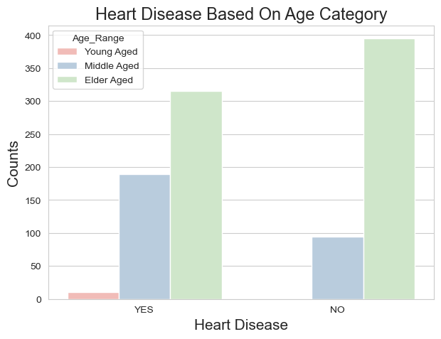
Which age category people affected by Heart Disease mostly ?
-> Elder Age People are most affected by Heart Disease and Middle Age People are mostly free from any kind of Heart Disease.

Slide 7
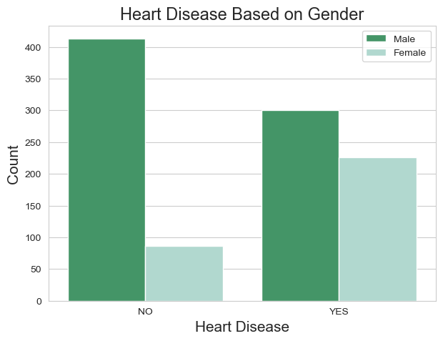
Heart Disease based on Gender
-> We can see that Males are mostly tend to have Heart Disease

Slide 8
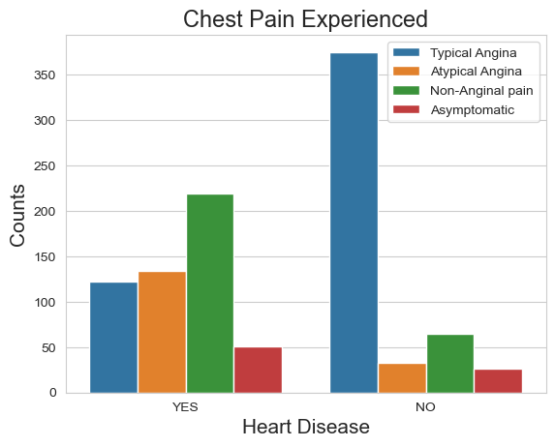
Is everyone Experienced Chest Pain
-> It seems people having Non-Anginal chest pain have a higher chance of heart disease
-> Typical Angina Chest pain means neither causing nor exhibiting symptoms of Heart disease.

Slide 9
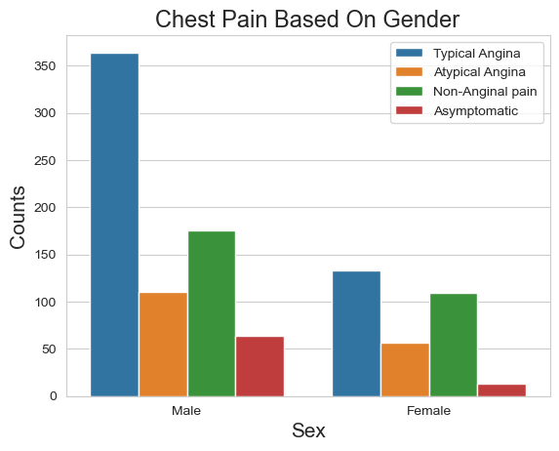
Chest Pain based on Gender
-> We can see that a higher number of men are suffering from Typical Angina type of Chest Pain

Slide 10
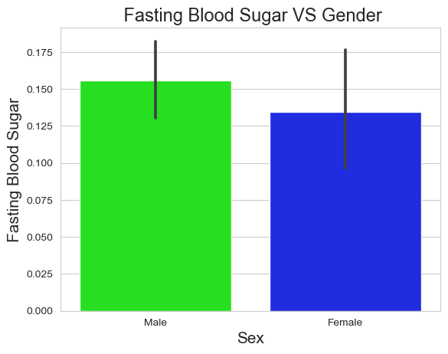
Blood Sugar based on Gender
-> Males have high number of Fasting Blood Sugar over 120

Slide 11
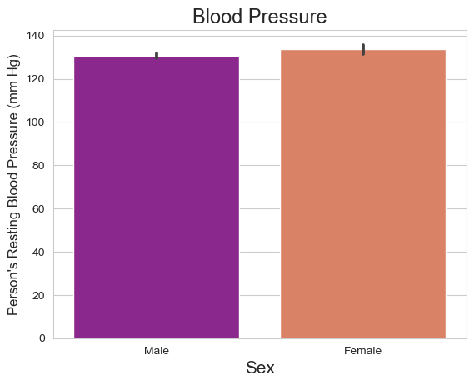
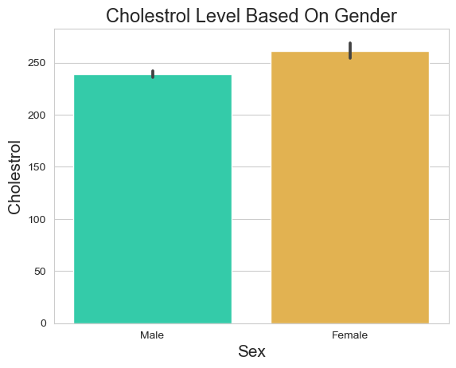
BP and Cholestrol Level based on Gender
-> Blood Pressure Rate is almost equal in Males and Females
-> females have little bit of higher cholesterol than males

Slide 12
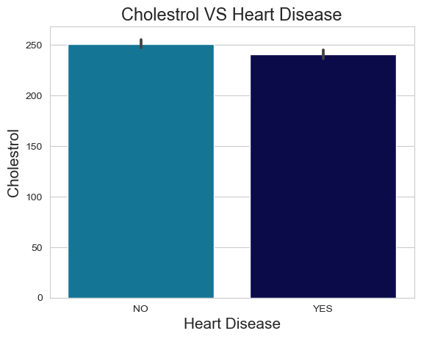
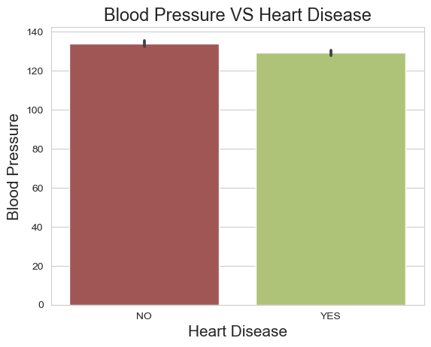
BP and Cholestrol Level based on people affected by Heart Disease
-> Higher Cholestrol Level causes Chances Of Heart Disease
-> Higher Blood Pressure Level results Chances Of Heart Disease

Slide 13
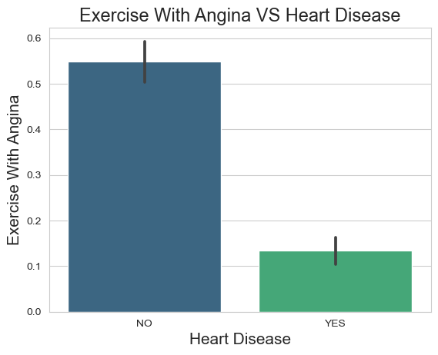
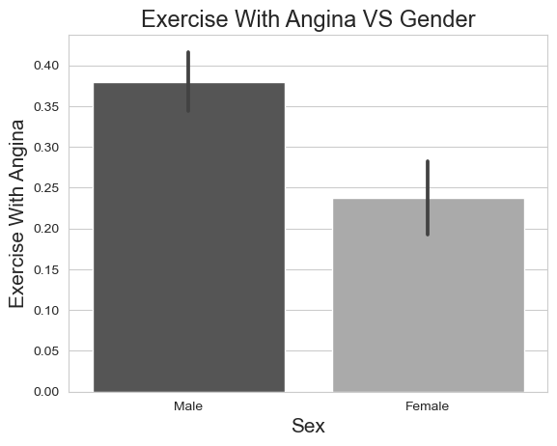
Exercise with Angina based on Gender
-> If you suffer from Angina, you may be concerned that exercise but seems like it will not make your symptoms worse.
-> Males do Exercise when having Angina -> Angina - A type of chest pain caused by reduced blood flow to the heart.

Slide 14
CONCLUSION
From the overall population, people having heart disease (51%) are greater than those who have heart disease(49%)..
Elder Age People are most affected by Heart Disease and Middle Age People are mostly free from any kind of Heart Disease.
We can see that Males are mostly tend to have Heart Disease
It seems people having Non-Anginal chest pain have a higher chance of heart disease
Typical Angina Chest pain means neither causing nor exhibiting symptoms of Heart disease.
We can see that a higher number of men are suffering from Typical Angina type of Chest Pain
Males have high number of Fasting Blood Sugar over 120
Blood Pressure Rate is almost equal in Males and Females but females have little bit of higher cholesterol than males
Higher Cholestrol Level and Higher Blood Pressure Level causes Chances Of Heart Disease

Slide 15
DATA VISUALIZATION (HEART DISEASE DIAGNOSTIC ANALYSIS)
View in Power BI

Slide 16
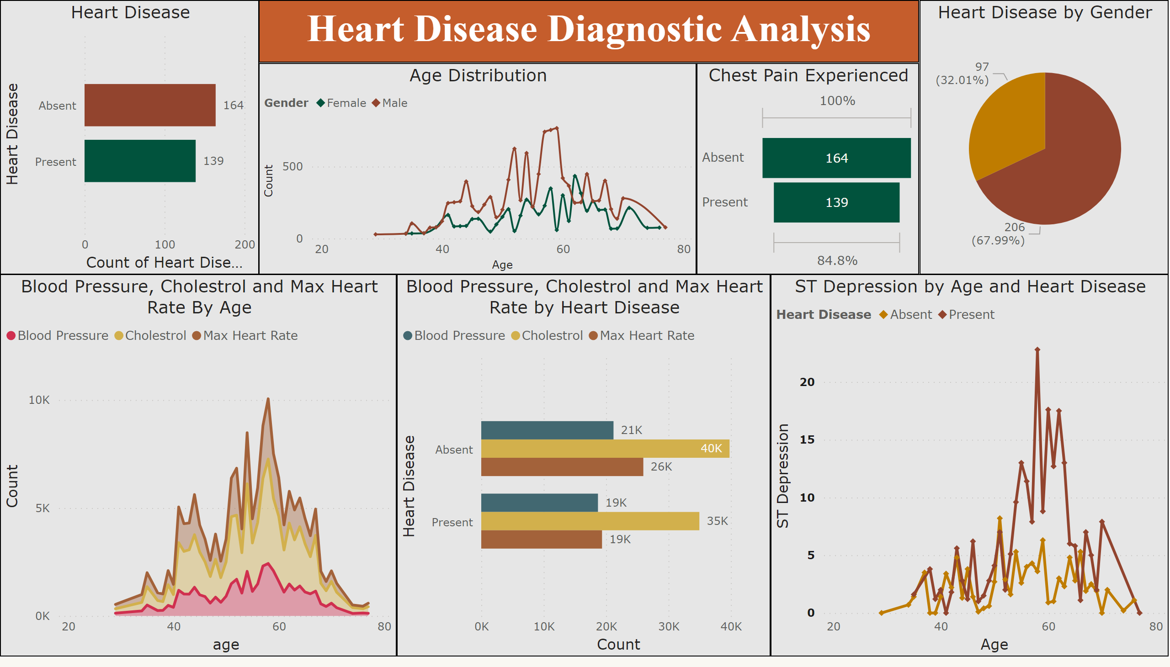
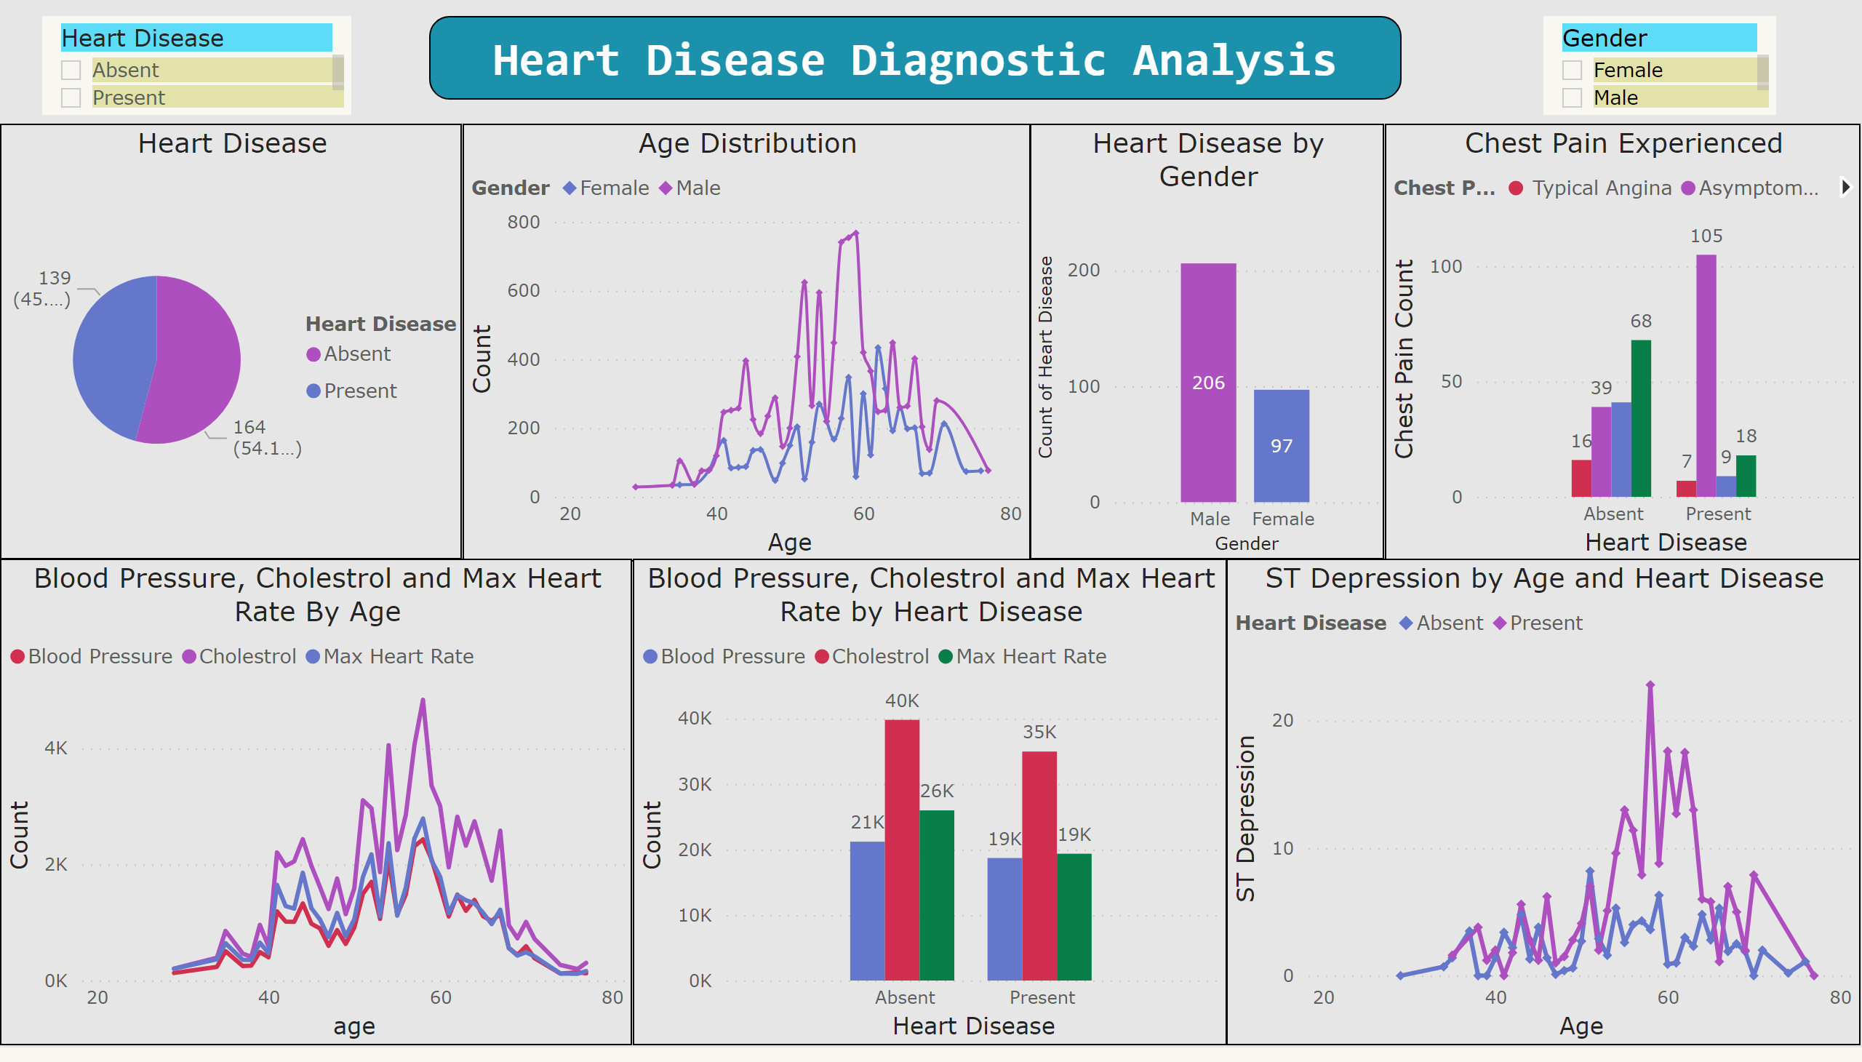

Slide 17
THANK YOU

